Slide 1

Open Technology Workshops
SERVICES
Privacy-respecting Online Services and Apps

Slide 2



Open Technology Workshops
The Challenge
Can you get by without using a service tied to...
List all the products you use by those three...
Alphabet Inc. | Microsoft Corporation | Apple Inc.

Slide 3
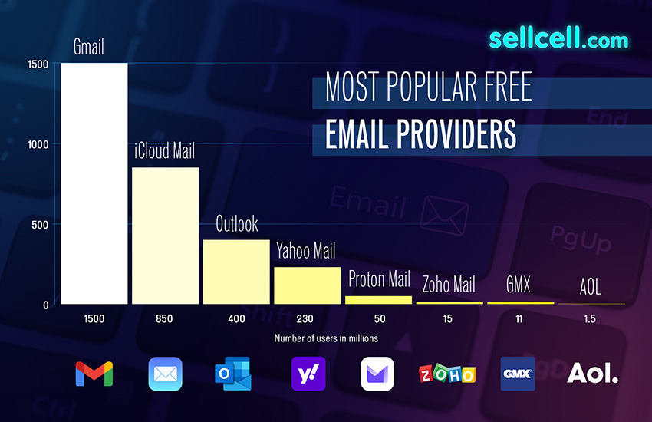


Open Technology Workshops
Start with Email
Email is the beginning of your online identity.
Use a service that does not sell your data to advertisers (like Gmail and Yahoo) or perpetuate monopolistic power (like Microsoft and Apple).
A note: Encrypted email services are great, but email itself is still not private. Find a provider that doesn’t sell your behavior or use the “free” service as a means to lock you into their ecosystem.
Take advantage of Email Aliasing Services
Simplelogin (owned by Protonmail) and addio.io are great ways to reduce junk in your inbox and tracking.

Slide 4
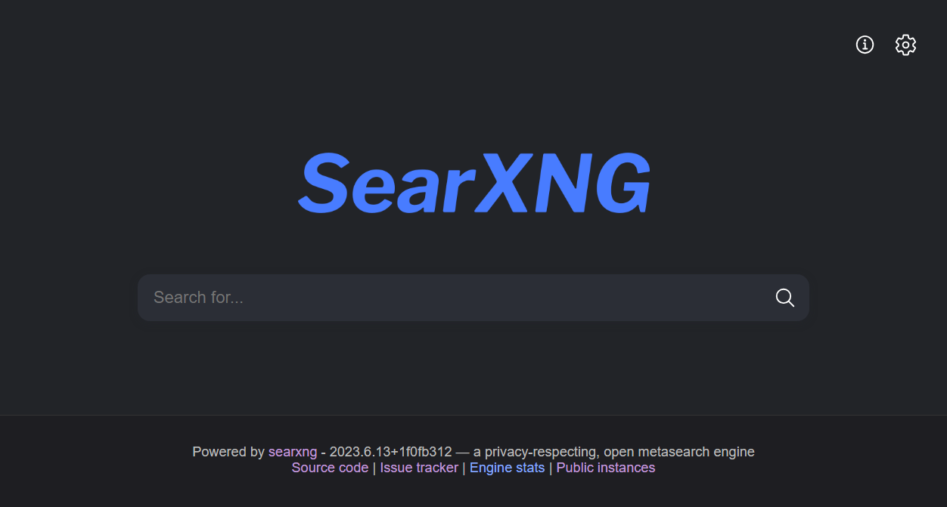
Open Technology Workshops
Secure your Searches
What can Google and Bing do to me?
A list of your online searches can reveal the most private aspects of your lives. Yet, we blindly trust search engines with our most intimate queries expecting meaningful and relevant answers. But business don’t provide their search engines for free. Your searches primarily serve as a means to deliver advertisements to you.
We must also remember, search histories can and have been used to embarrass, incriminate, and endanger people for a plethora of reasons.
Try SearXNG!
SearXNG is a free internet metasearch engine which aggregates results from more than 70 search services. Users are neither tracked nor profiled.
Go to https://www.libretechnica.org >
Click on “Private Search”
Bookmark it!

Slide 5

Open Technology Workshops
Other Common Services
Cloud Storage
ProtonDrive
Tresorit
or use Google Drive of Onedrive with Cryptomator
DNS Resolvers
AdGuard
PiHole (self-hosted)
or just change your default DNS address to quad9 instead of Google’s 8.8.8.8 or your ISP’s own resolver.

Slide 6
Open Technology Workshops
Check the Privacy Policies
Try on a Raspberry Pi | Easy as pi! Quick to get set up, but can be slow on older Pis.
Install it on a virtual machine | The most versitile way to try without committing. Can boot to live ISOs or install.
Use an old laptop | Get the full install experience, see how it runs on bare metal.
Dual boot (separate drive from main OS) | Safe way to install on a PC without conflicting with Windows.
Dual boot (different a different partition) | More potential for conflicts, but can be useful on laptops.
Mainline it | Just go all in!
Additional tips: https://www.howtogeek.com/ways-to-start-using-linux/

Slide 7
Open Technology Workshops
Where to find more
More resources
https://search.libretechnica.org
https://www.privacyguides.org/
https://www.privacyguides.org/en/basics/common-threats/#privacy-from-service-providers
https://www.privacyguides.org/en/basics/account-creation/
https://libretechni.ca/
Thank you for coming!

